Slide 1



ACTIVE MOBILE POSITIONING AND DATA COLLECTION WITH SMARTPHONE
Rachid Berghout
Notes:
Anto Aasa

Slide 2
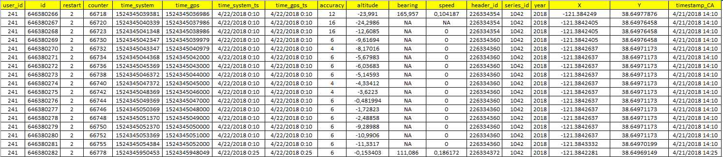
Smartphone based Data
Duration
From: Saturday, 21 April 2018, 14:10
To: Thursday, 10 May 2018, 13:56
18 days, 23 hours, 46 minutes
1 640 760 seconds
27 346 minutes
455 hours (rounded down)
18 days (rounded down)
2 weeks (rounded down)
5.20% of 2018

Slide 3
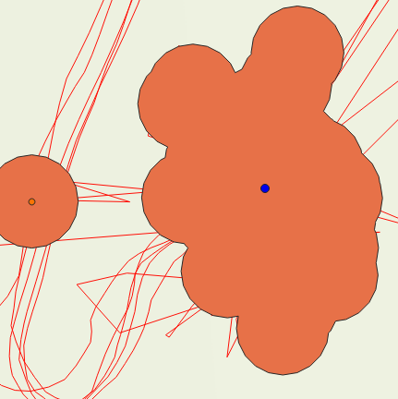
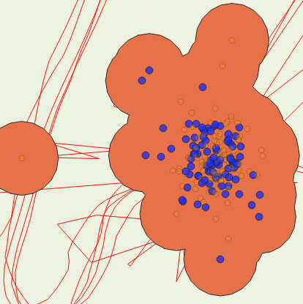
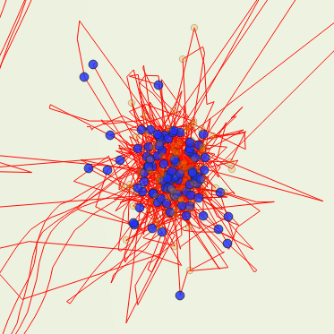
Processed Steps
BOOKING & TRAFFIC
CREATIVE SOLUTIONS
3
MARKETING STRATEGY
2
1

Slide 4
Number of stops per days
Total: 1727
Min: 6
Max: 96
Average: 86

Slide 5
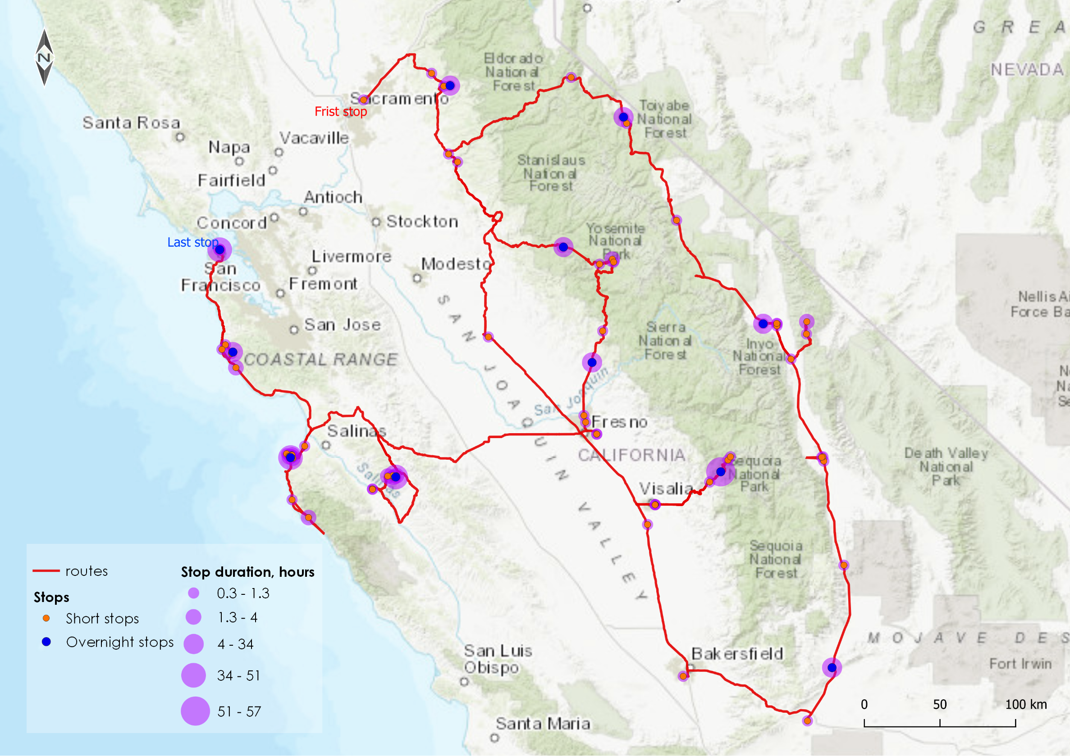
Stops and trajectories

Slide 6
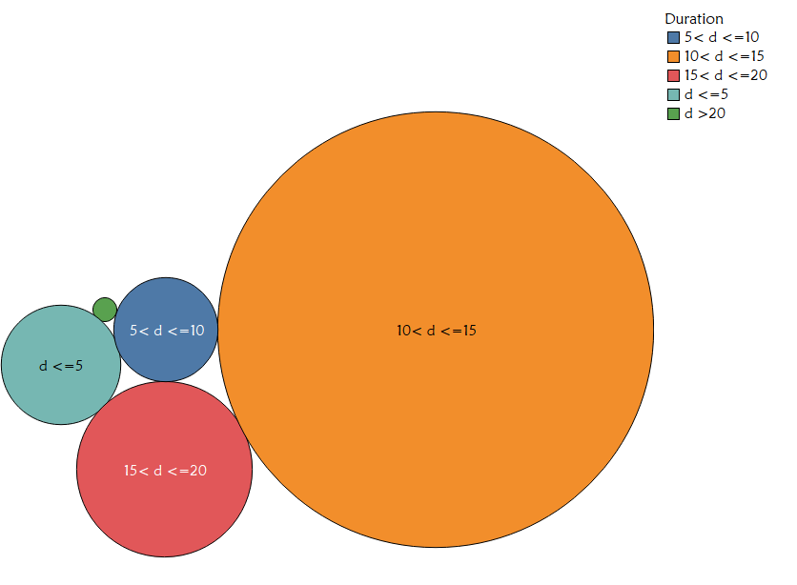

Duration (minutes) of stops
01:05
47:17
13:53
Min
Mean
Max
76
1330
100
216

Slide 7
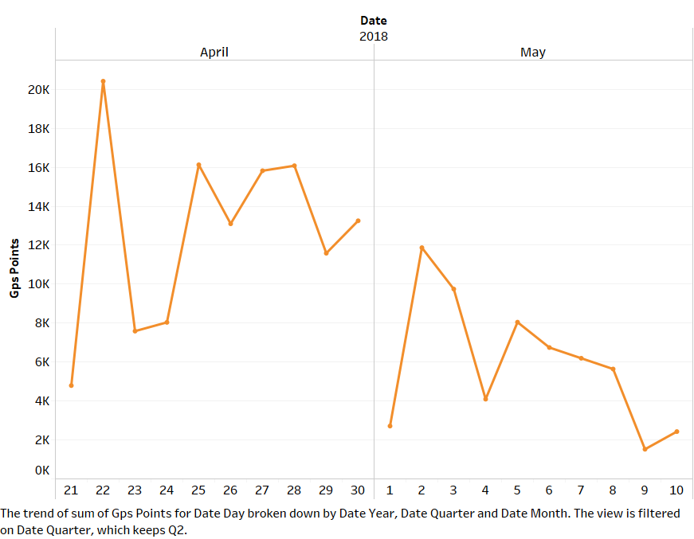
GPS points per day
2018
April
May
Max: 20420
GPS points
Min: 1522

Slide 8
Distance (km) per days
Total: 3433.2 km
Min: 1.77 km
Max: 433.1 km
Average: 171.6 km

Slide 9
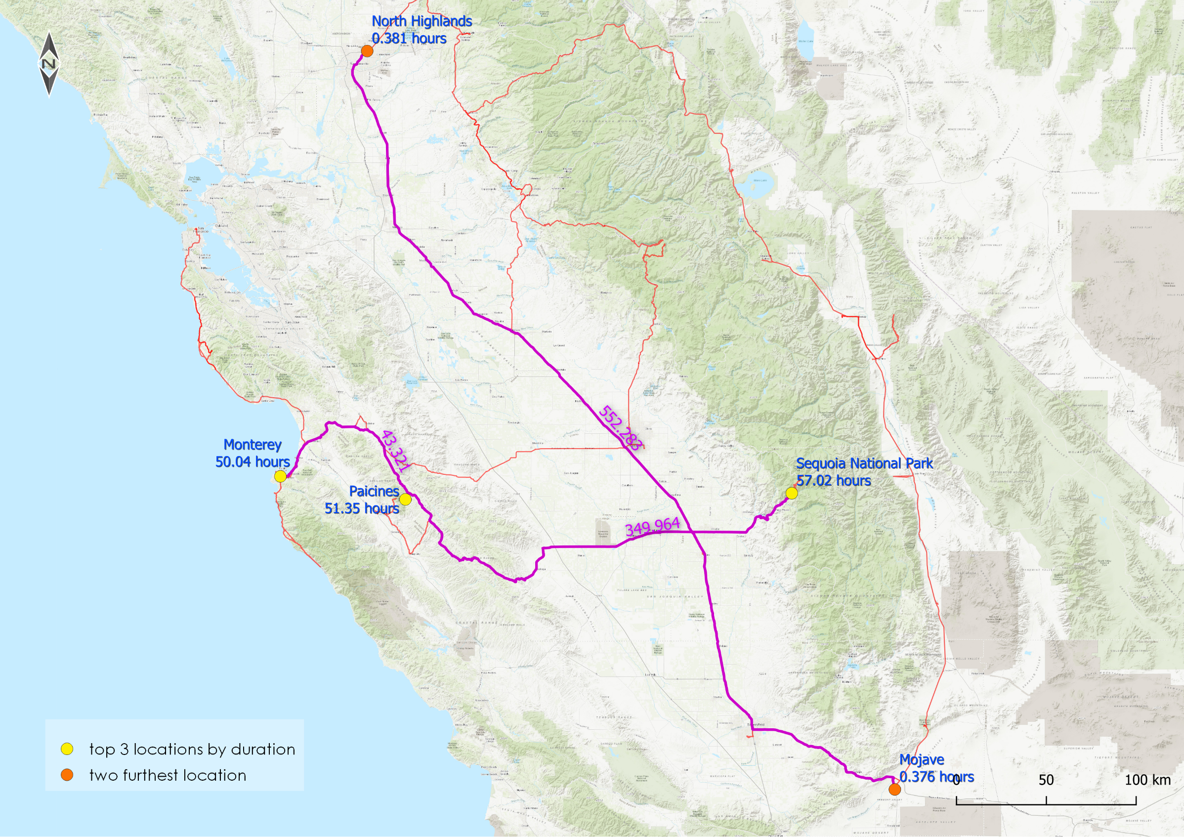
Important locations

Slide 10

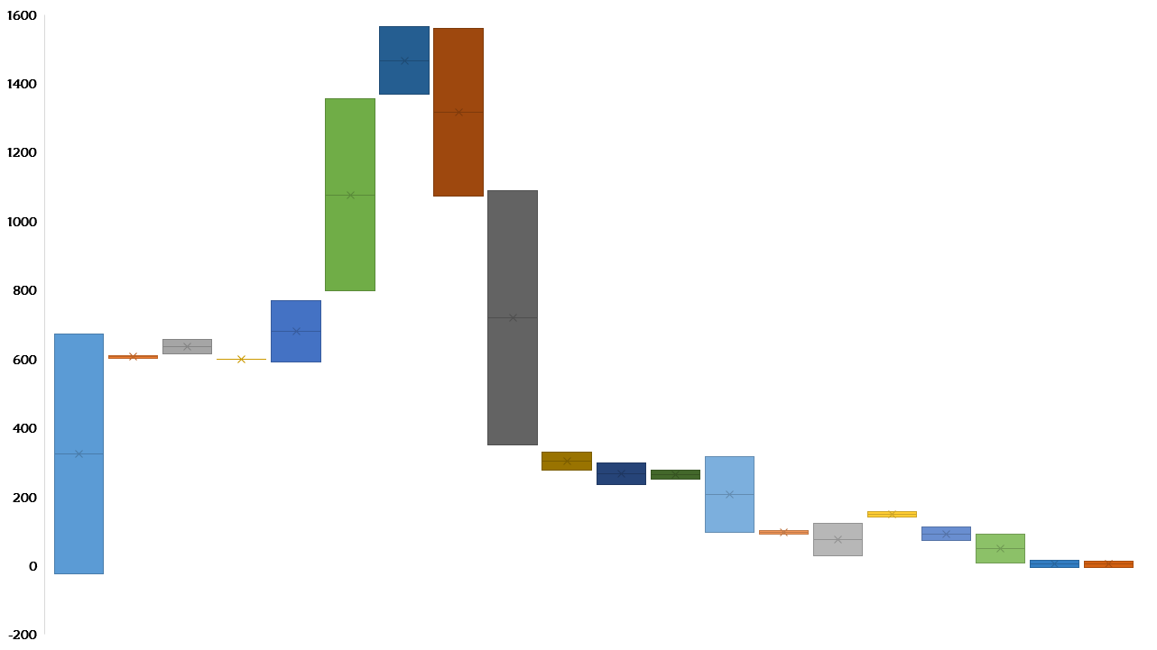
1564
1561
Altitude (m) per days
1356
1368
1088
1072
770
798
672
657
609
615
601
603
598
591
350
331
316
299
276
278
250
234
157
103
123
140
112
92
96
91
72
30
16
14
-24
9
-4
-5

Slide 11
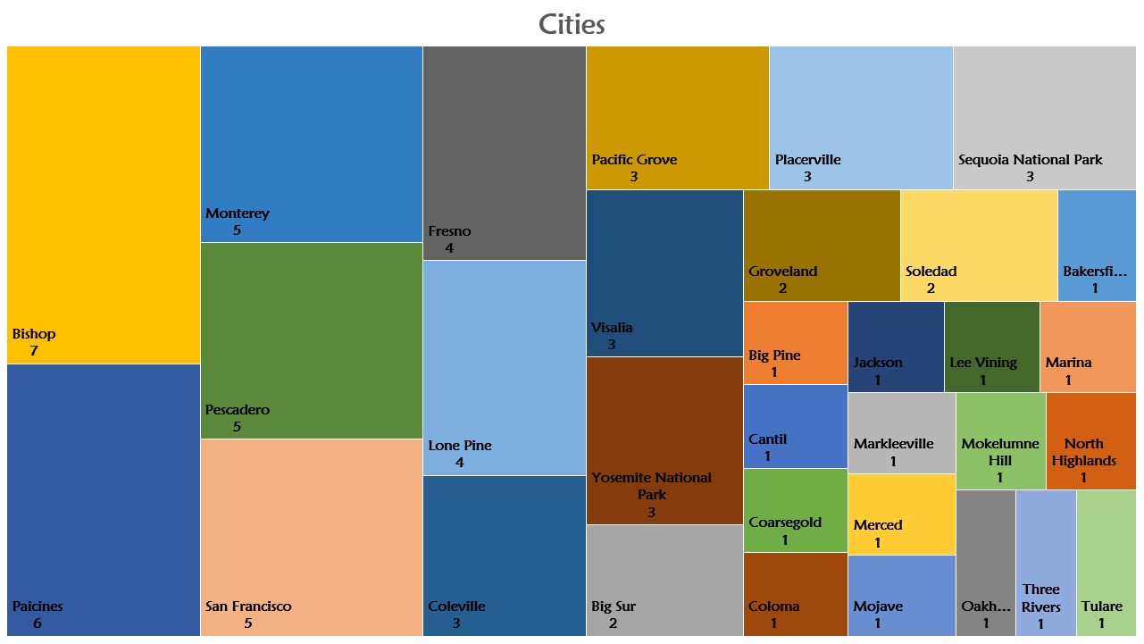

Slide 12
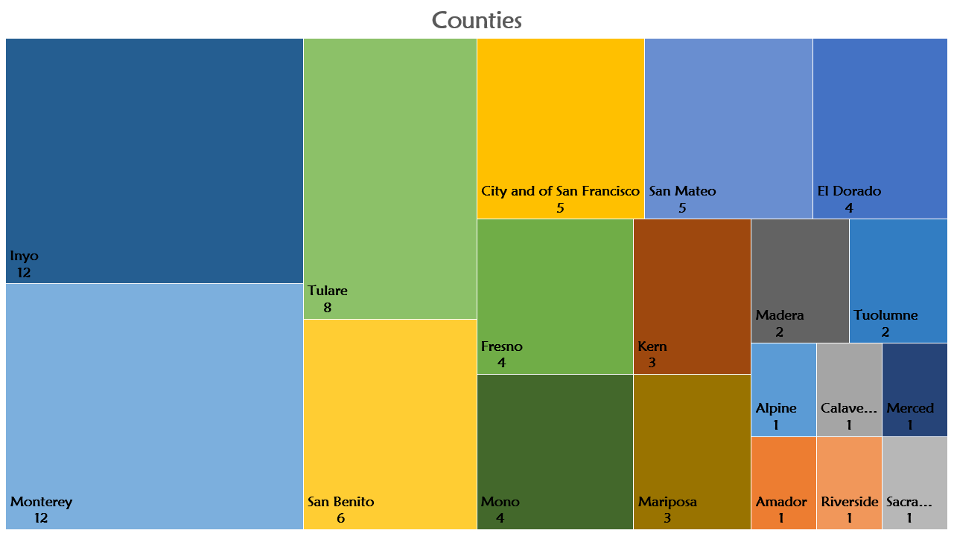

Slide 13
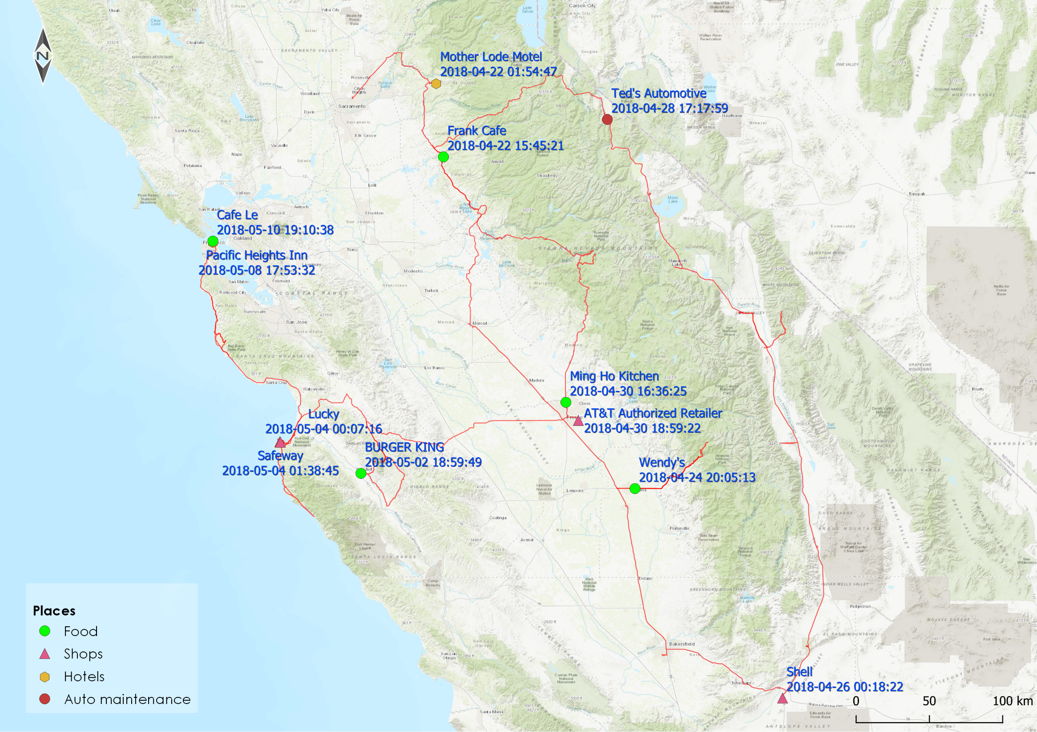
Activities

Slide 14
Thank you !

